Slide 1

Navigating the Sharing Economy:
Strategies and Insights for Airbnb in Chicago
Group 5 : Audrey Jung, Jay Lee, Johnny Chang, Paul Yang, Zoe Chen

Slide 2


Agenda
Airbnb Overview
Purpose
Timeline
Data Selection and Cleaning
Data Analysis
Results
Conclusion

Slide 3

Purpose of the Analysis
To what extent does external factors impact hosts of Airbnb in Chicago?
How can Airbnb develop strategies to focus and motivate hosts to expand the Airbnb economy?

Slide 4

Airbnb Overview
Founded in 2008, grown 5M+ hosts with 7.7M+ listings welcomed 1.5M+ guest arrivals
A global online marketplace for lodging and tourism experiences
Airbnb's business model includes not only accommodations but also "Airbnb Experiences," which allow guests to book unique activities designed and led by locals
Airbnb has also expanded its offerings with initiatives like Airbnb Plus and Beyond by Airbnb, which cater to guests looking for higher quality or luxury experiences, respectively
Airbnb has significantly impacted the travel and tourism industry, providing an alternative to traditional hotel stays and fostering a culture of sharing economy.
https://news.airbnb.com/about-us/#:~:text=Airbnb%20was%20born%20in%202007,every%20country%20across%20the%20globe.

Slide 5
Timeline
Data Selection
Data Preprocessing
& Cleaning
Data
Understanding
Data
Analysis
Result

Slide 6


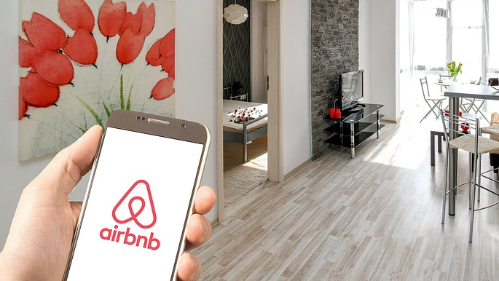
Data Selection
Dataset Choice:
Reviews.csv (410K+ reviews in Chicago Airbnb listings up to 2023)
Listing.csv (320K+ records for USA listings up to 2022)
Crucial variables (neighborhood, room type, availability) for insightful analysis
Data Source:
Inside Airbnb
Kaggle
Data Preparation:
Data cleaning by removing missing values and anomalies
Count the number of unique listings in reviews data based on the 'listing_id'
Group reviews by 'listing_id' to display the count of comments associated with each individual listing
Combine 2 datasets together to analyze

Slide 7
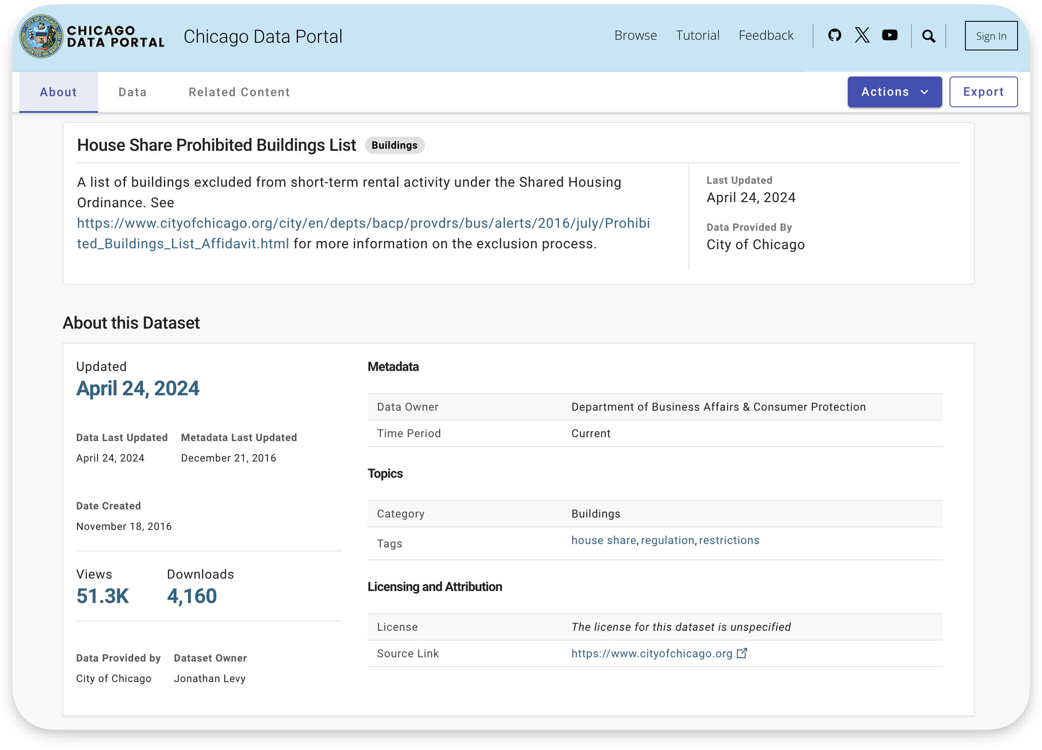
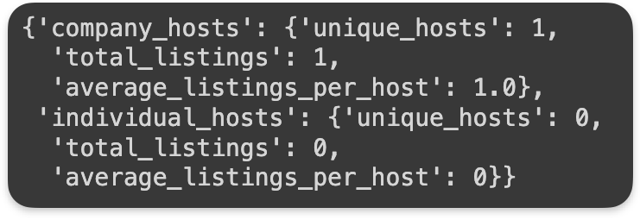
Prohibited Listing Check

Slide 8
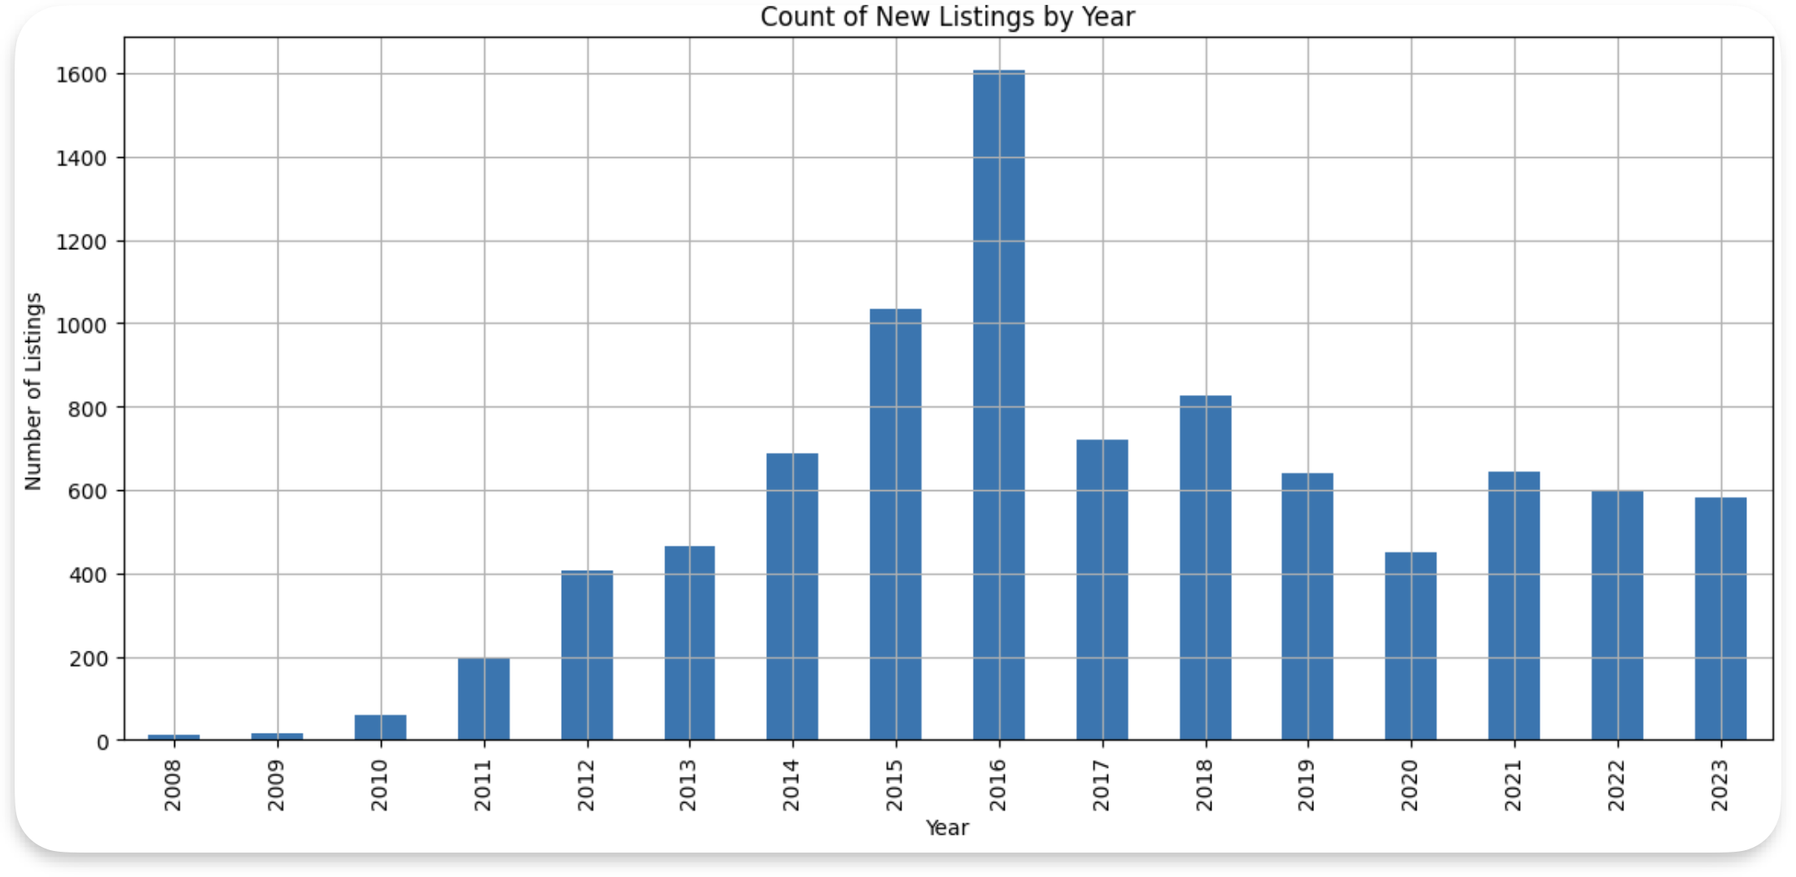
Overview of New Listings

Slide 9
Overview of New Listings

Slide 10

Listing Growth in 2016
Economic Incentive for Homeowners: a convenient and profitable way for homeowners to earn extra money
Influence of the Sharing Economy: the concept of sharing homes became more accepted and mainstream
Growing Popularity of Airbnb: more homeowners began to see the potential benefits of listing their properties
https://news.airbnb.com/airbnb-in-illinois-2016-in-review/
https://d3.harvard.edu/platform-rctom/submission/airbnb-how-the-sharing-economy-is-disrupting-the-travel-industry/
Notes:
Chicago represents a major source of growth, accounting for $65.2 million in supplemental income for Airbnb hosts while welcoming 380,000 people through the home sharing platform in 2016.

Slide 11

New Ordinance in 2016
High Tax Rate: a 21% tax on short-term rentals, combining a 4% surcharge with the city's 17.4% hotel tax
Registration Requirement: must register with the city to obtain a number and get their application approved
Heavy Fines for Non-compliance: Violations and bans can lead to fines ranging from $5,000 to $10,000
Limitations on Units in Buildings: Buildings with fewer than five residential units could only have one unit listed as an Airbnb, while buildings with five or more units were limited to listing up to 25%
Guest Registration Records, Inspections
https://www.illinoispolicy.org/chicago-city-council-enacts-airbnb-regulations/
https://www.chicago.gov/city/en/depts/bacp/supp_info/sharedhousingandaccomodationslicensing.html
https://www.domu.com/blog/airbnb-chicago-laws
https://www.mashvisor.com/blog/airbnb-chicago-investment-property-ordinance/

Slide 12
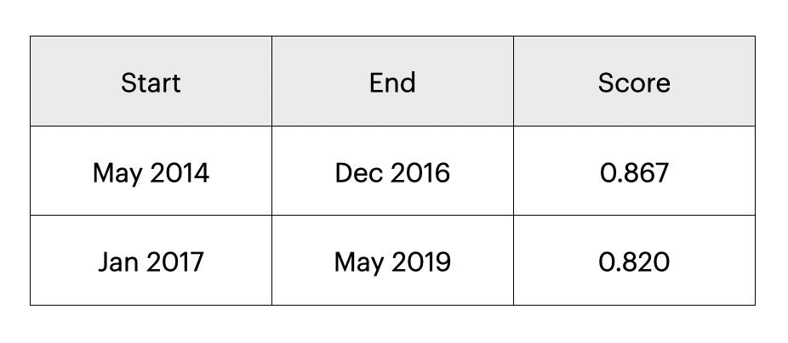
Sentiment Analysis of Reviews

Slide 13
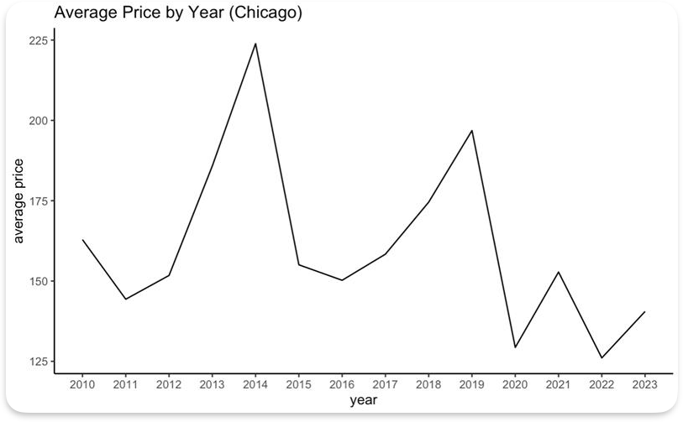
Overview of Listing Price

Slide 14
Overview of Listing Price

Slide 15


Who are the hosts?
Individuals
Companies
~1.5 Listings per Host
~9.5 Listings per Host

Slide 16
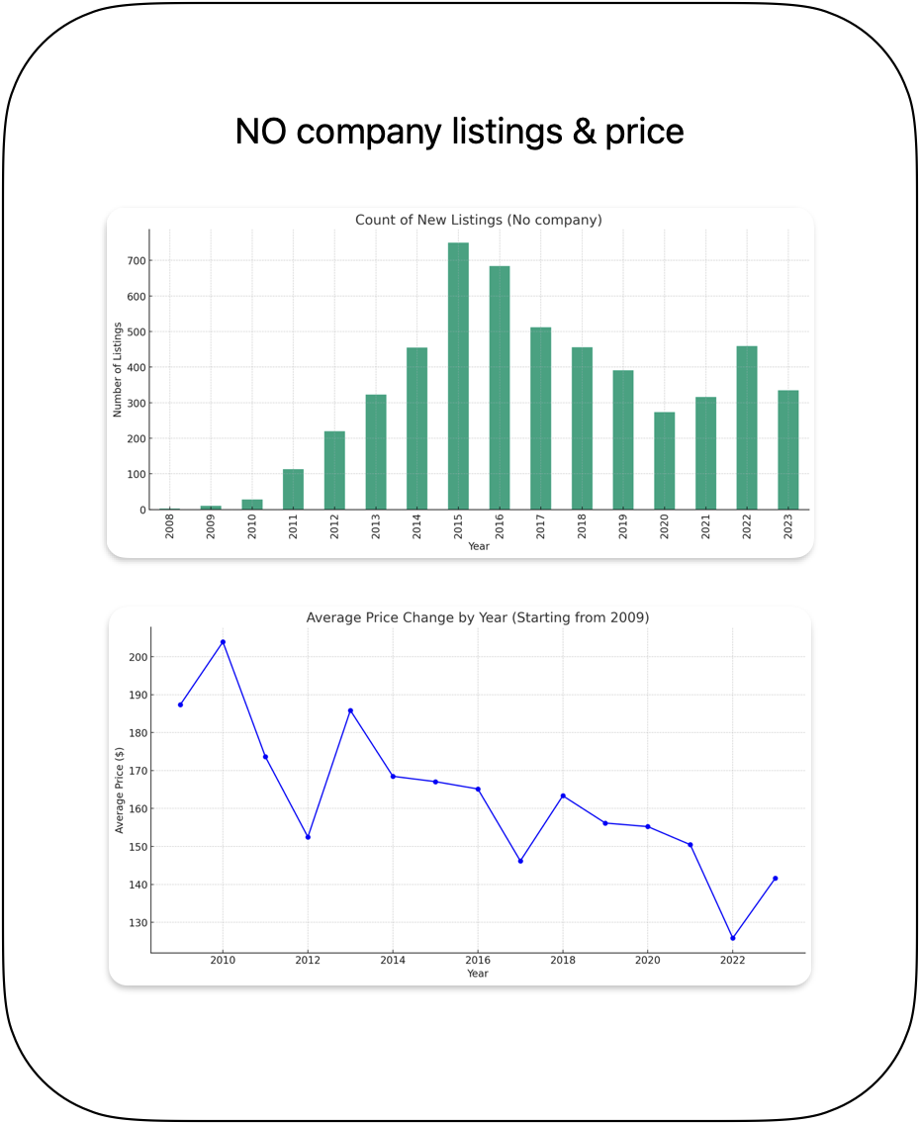
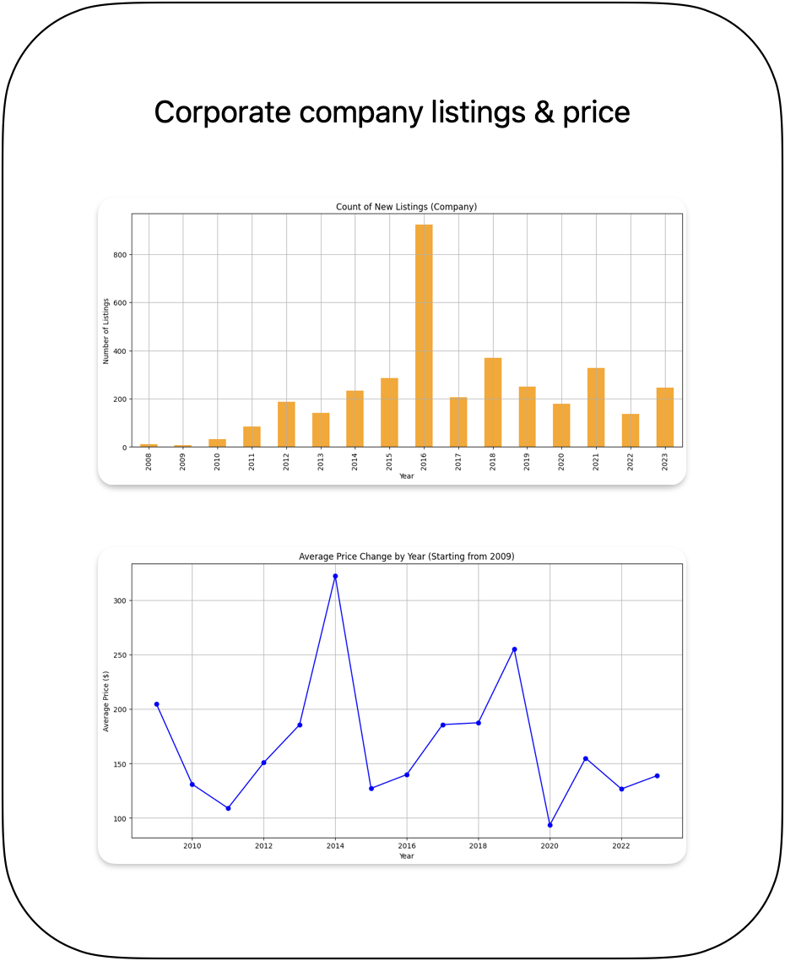
Trend of listings
by
host type

Slide 17
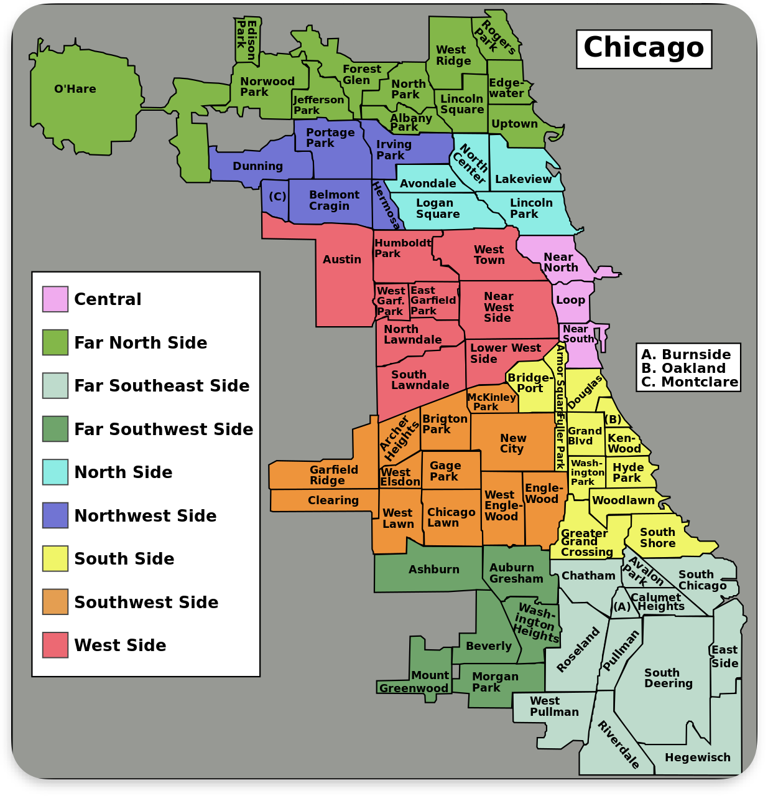
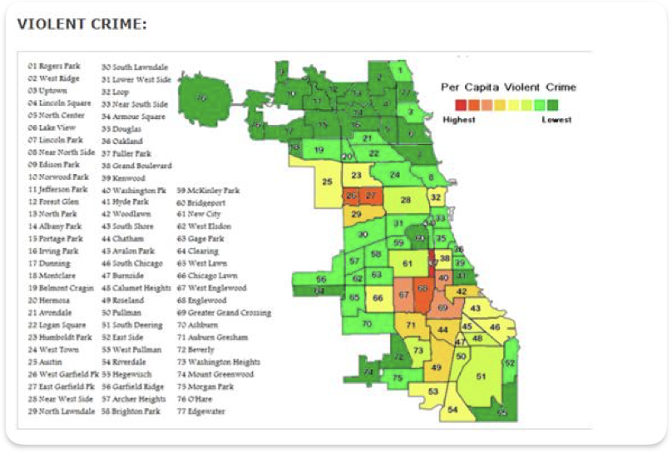
Chicago Region and Community

Slide 18
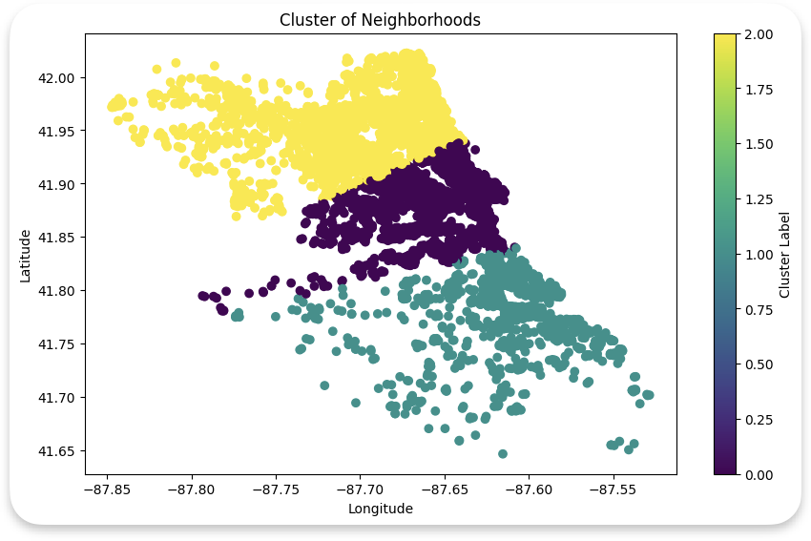
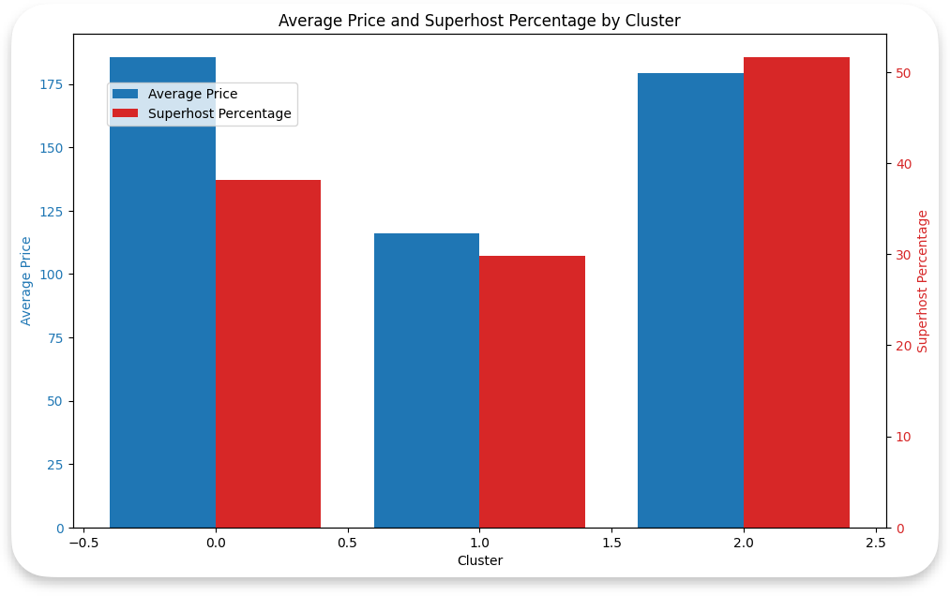
Unsupervised ML Clustering with 3 groups

Slide 19
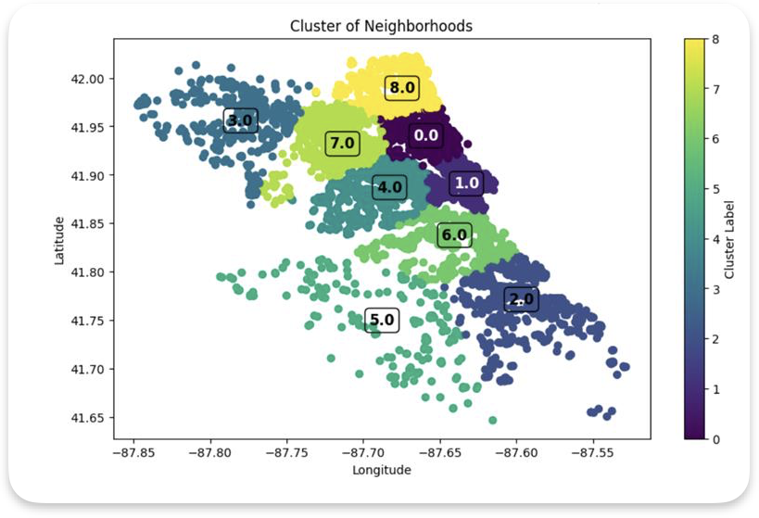
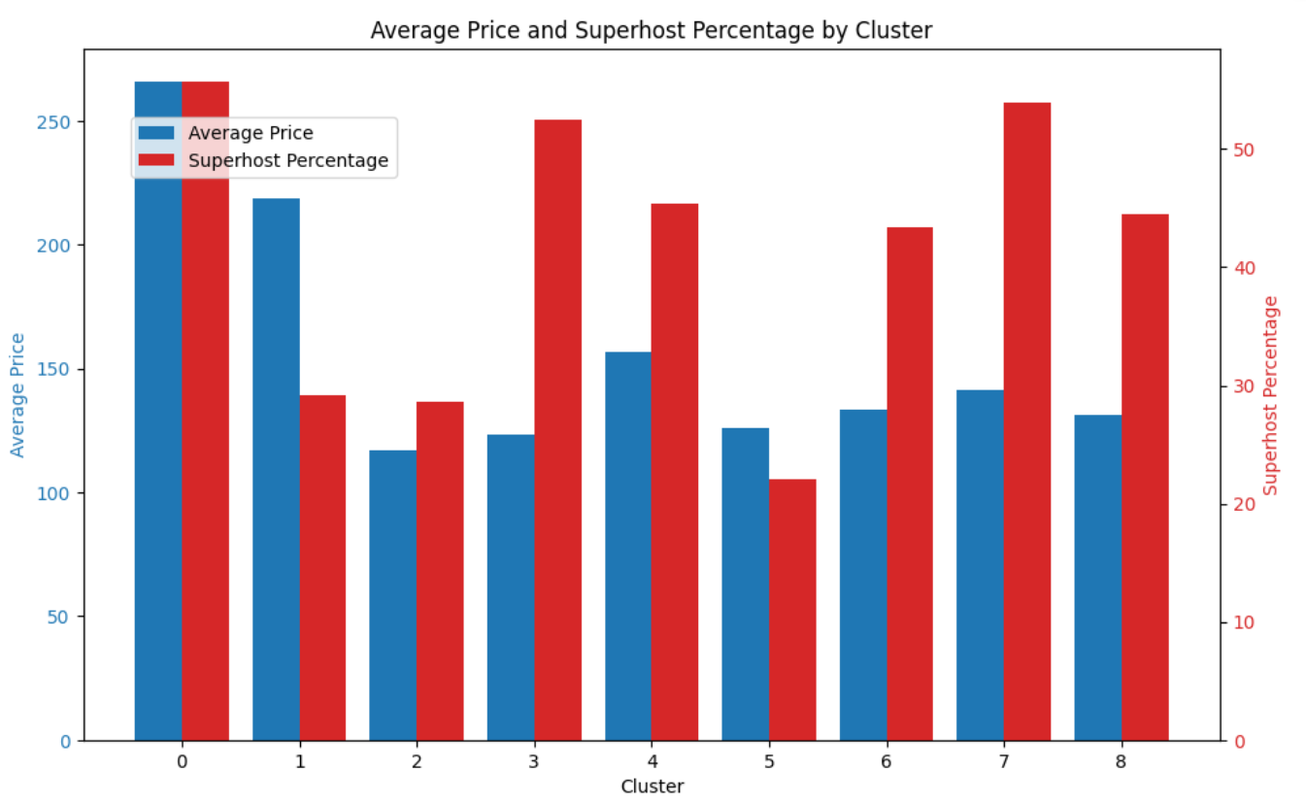
Unsupervised ML Clustering with 9 groups

Slide 20
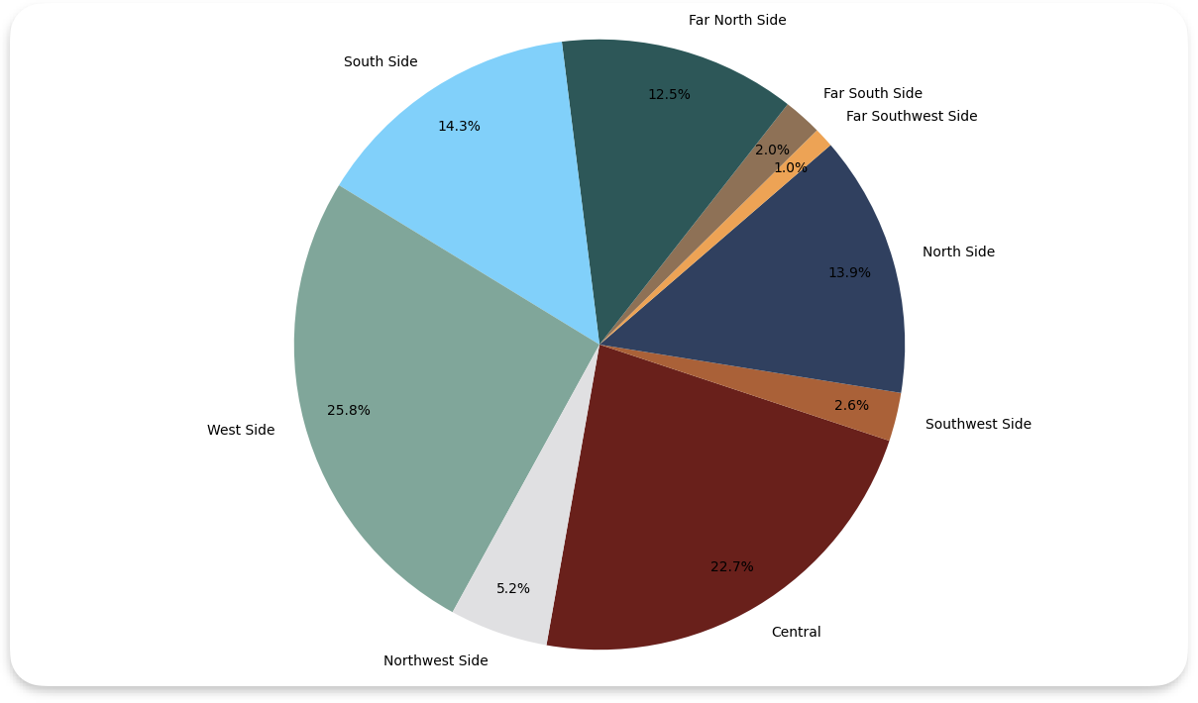
Airbnb Popular Region

Slide 21
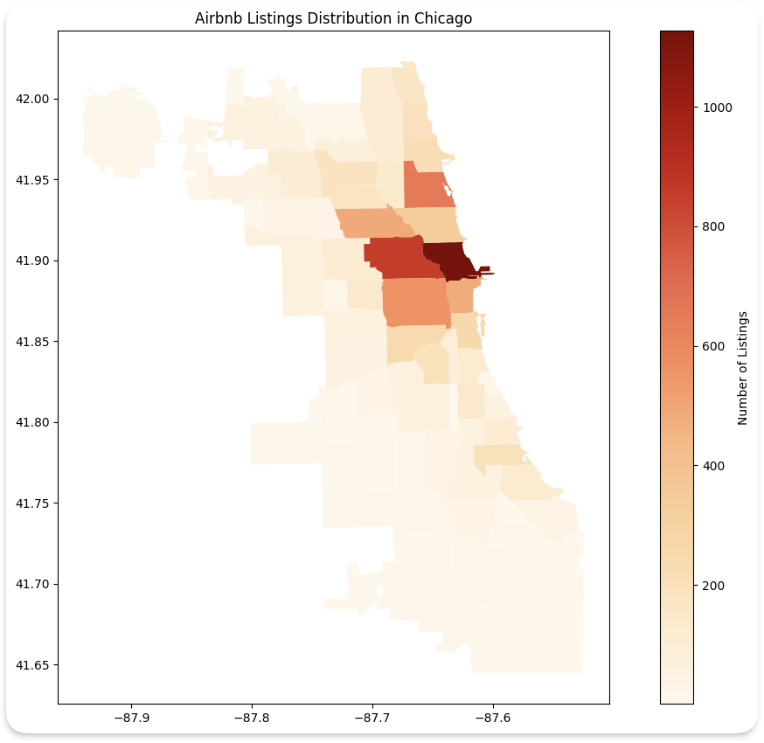
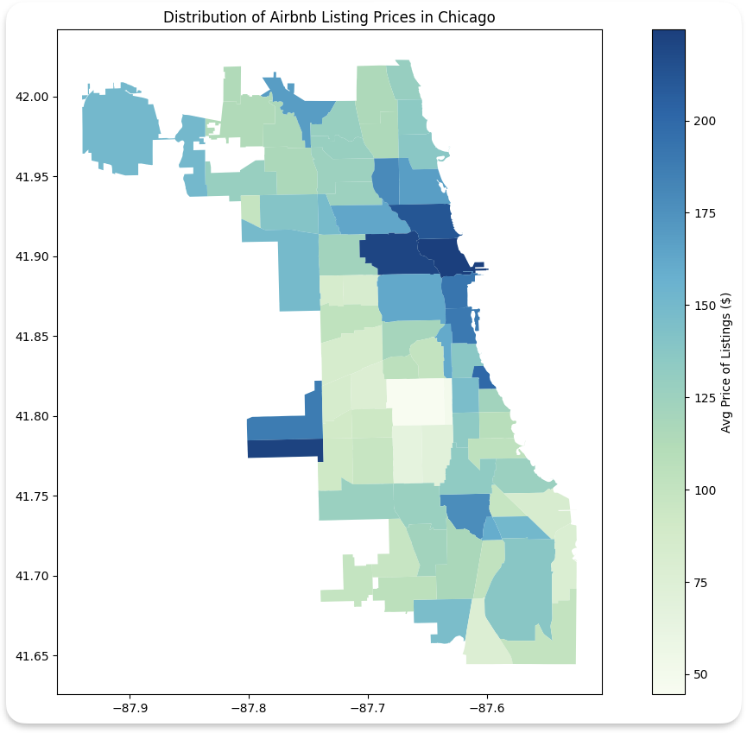
Regional Listing Number and Price

Slide 22
Tourism popularity
2019, Chicago hosted 55.2 million tourists
Over 5.4 million people visited Navy Pier in 2019
In 2018, The Millennium Park was the top tourist attraction in Chicago with nearly 25 million visitors
Hotel occupancy rate in the central region of Chicago, specifically in the Loop area, reached 75% in the third quarter of 2023
Average occupancy rate for the city was around 63.1% in October 2023
https://gitnux.org/chicago-tourism-statistics/
https://www.thecentersquare.com/illinois/article_9ac150ac-0494-11ee-949e-f75c733c841d.html
https://www.costar.com/article/1518177689/chicago-insiders-tourism-heats-up-as-office-occupancy-still-lags

Slide 23
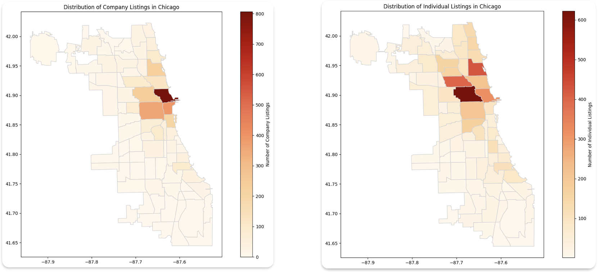
Regional Listing Company vs Individual

Slide 24
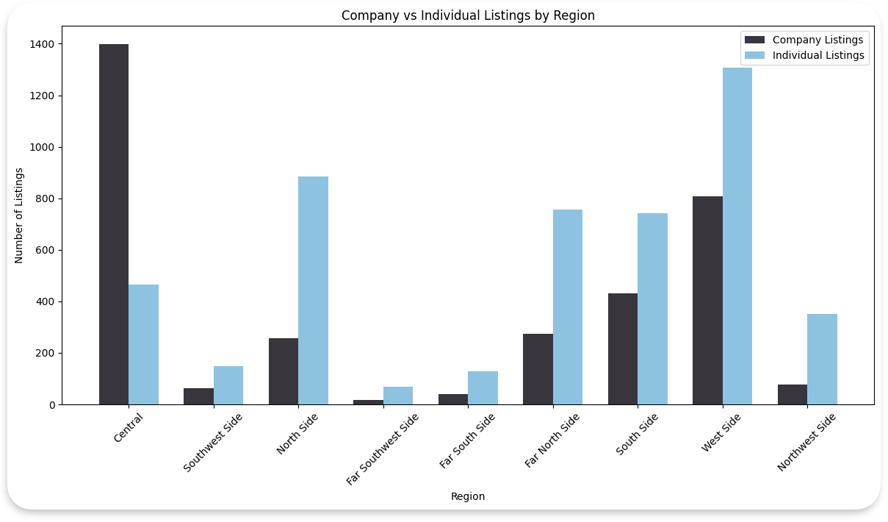
Regional Comparison

Slide 25
Linking back

Slide 26
Policies affect individuals stronger
Why Ordinance?
Concerns on
City's housing market
Quality of life
The hotel industry.
Individual hosts
Lower Quality listings | service

Slide 27
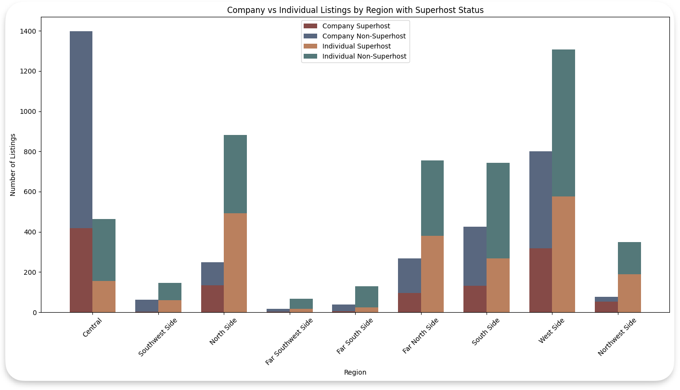
Companies have less Super Host

Slide 28
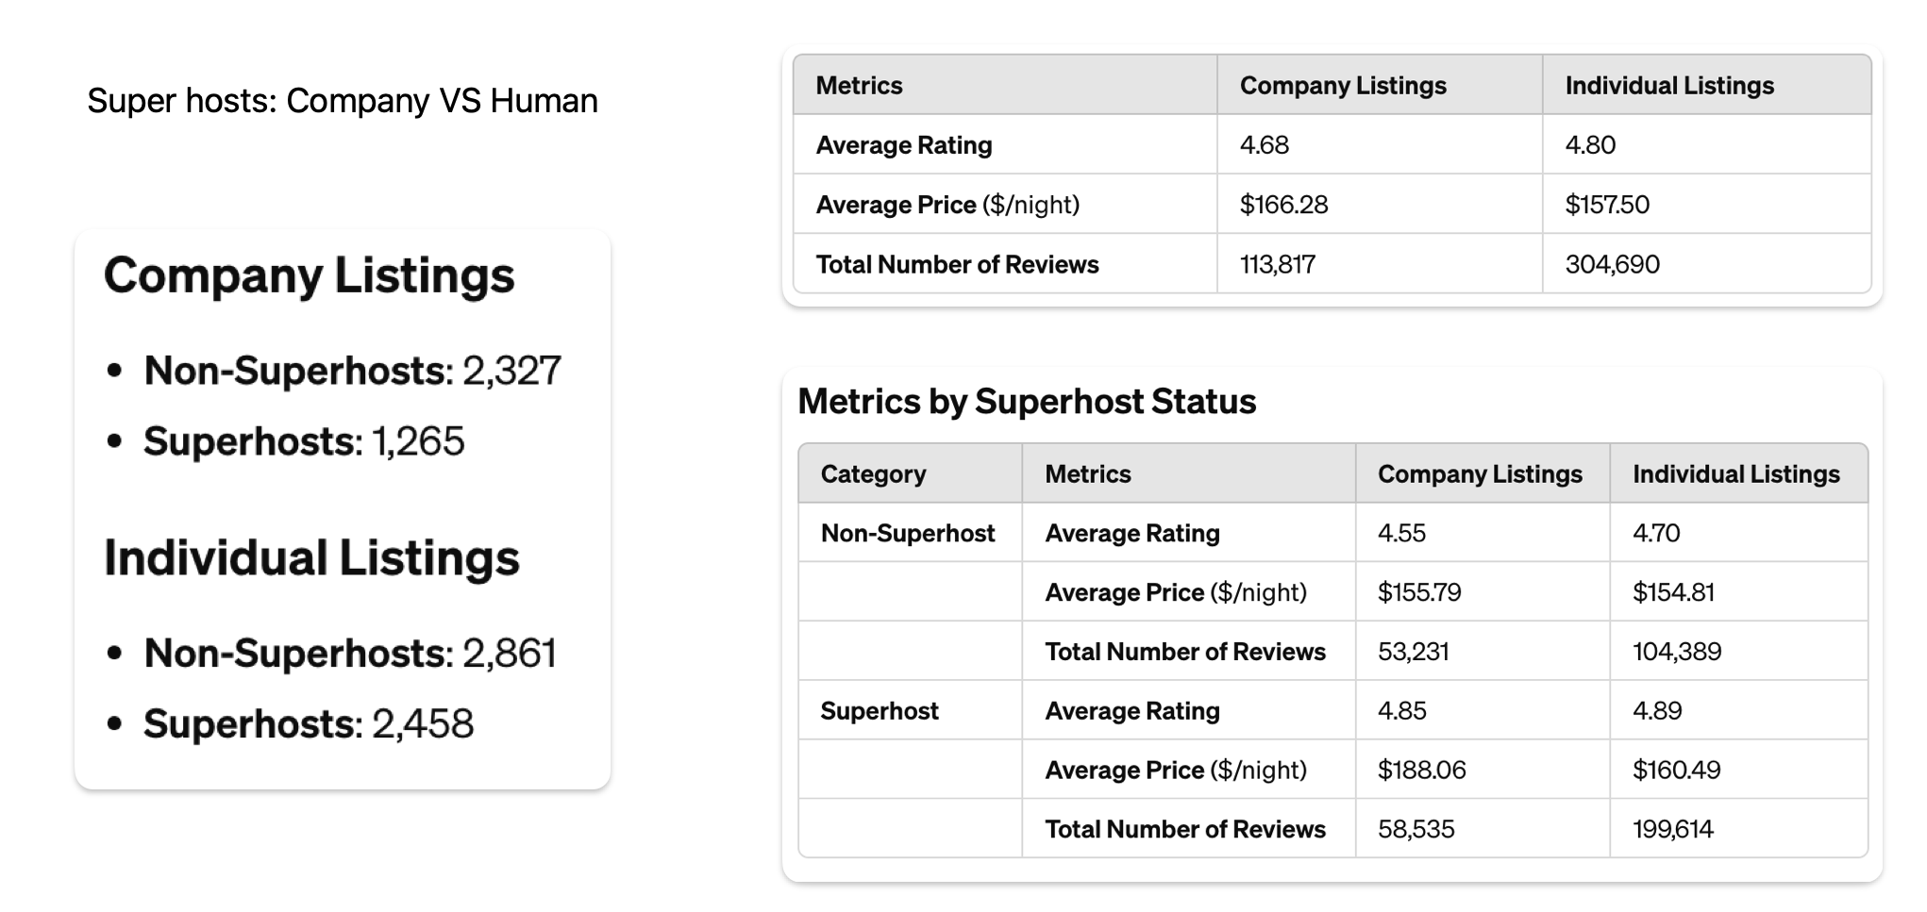
Super Hosts

Slide 29
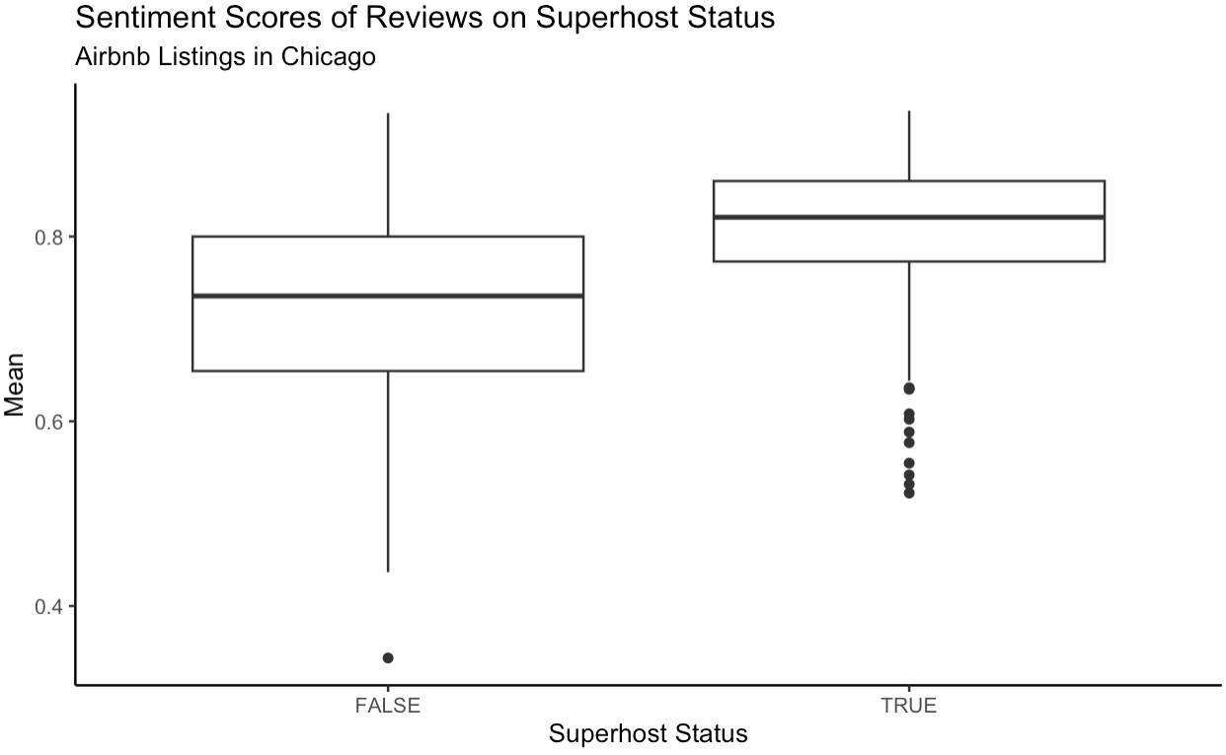
Super Hosts
https://www.airbnb.com/d/superhost/1000

Slide 30
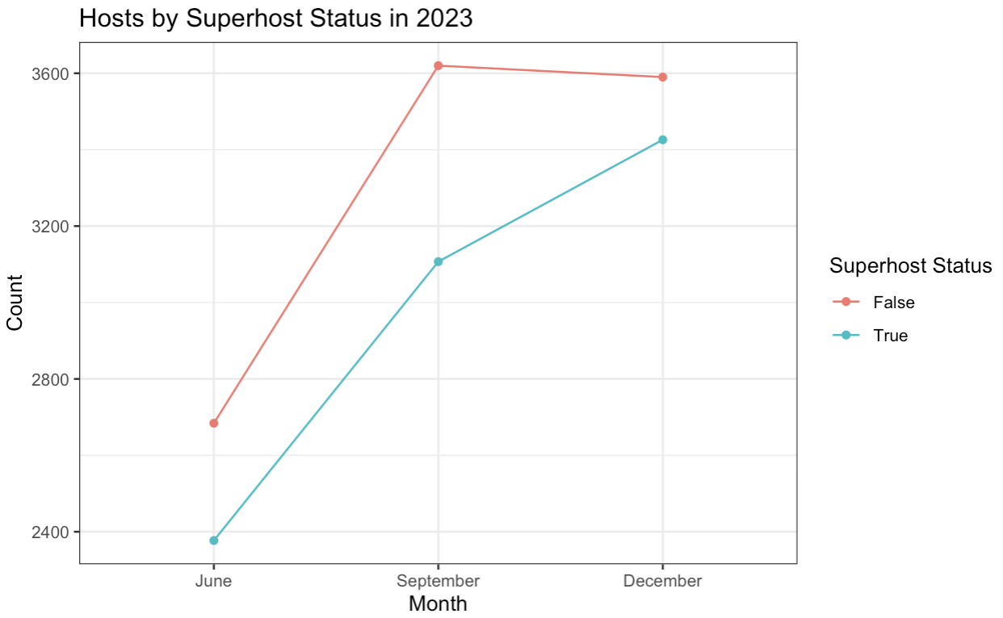
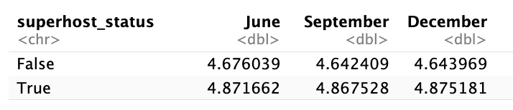
Super Hosts
https://www.airbnb.com/help/article/829, https://news.airbnb.com/airbnb-celebrates-1-million-superhosts/

Slide 31
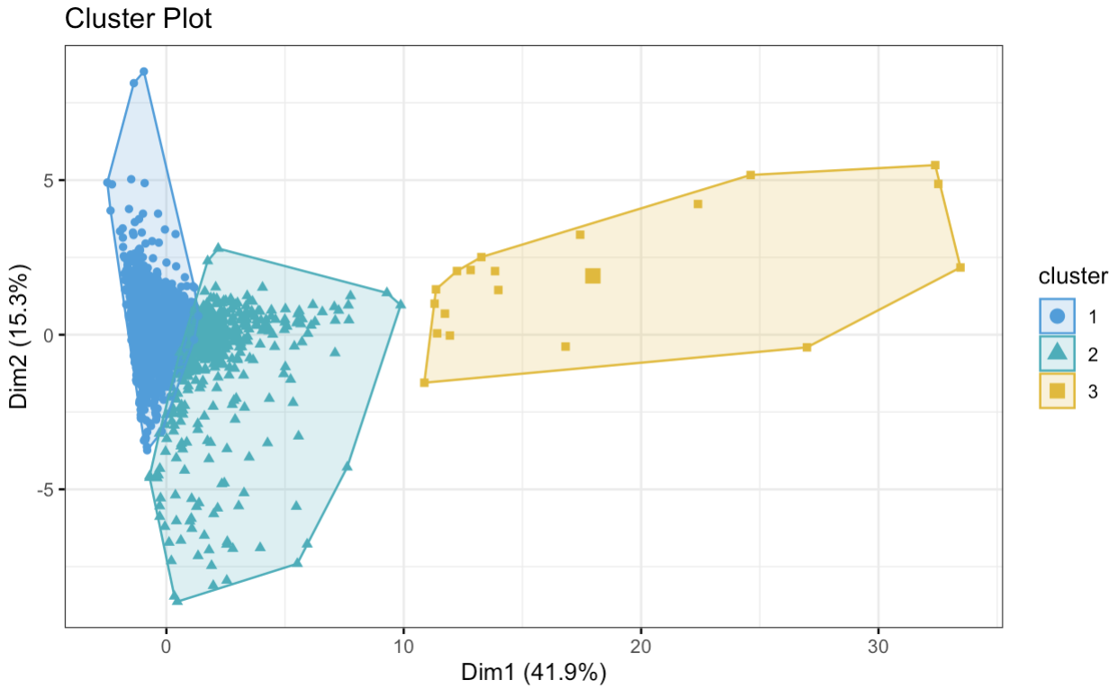
Super Hosts
https://abnb.co/d3jcs

Slide 32
Super Hosts

Slide 33
Conclusion
Chicago city policies have higher influence on individual hosts
Superhost program should focus on individual hosts
Diversifying the superhost program will provide access to more hosts
Expanding the superhost program will develop the Airbnb economy

Slide 34
Thank you

Slide 35

Q&A

Slide 36
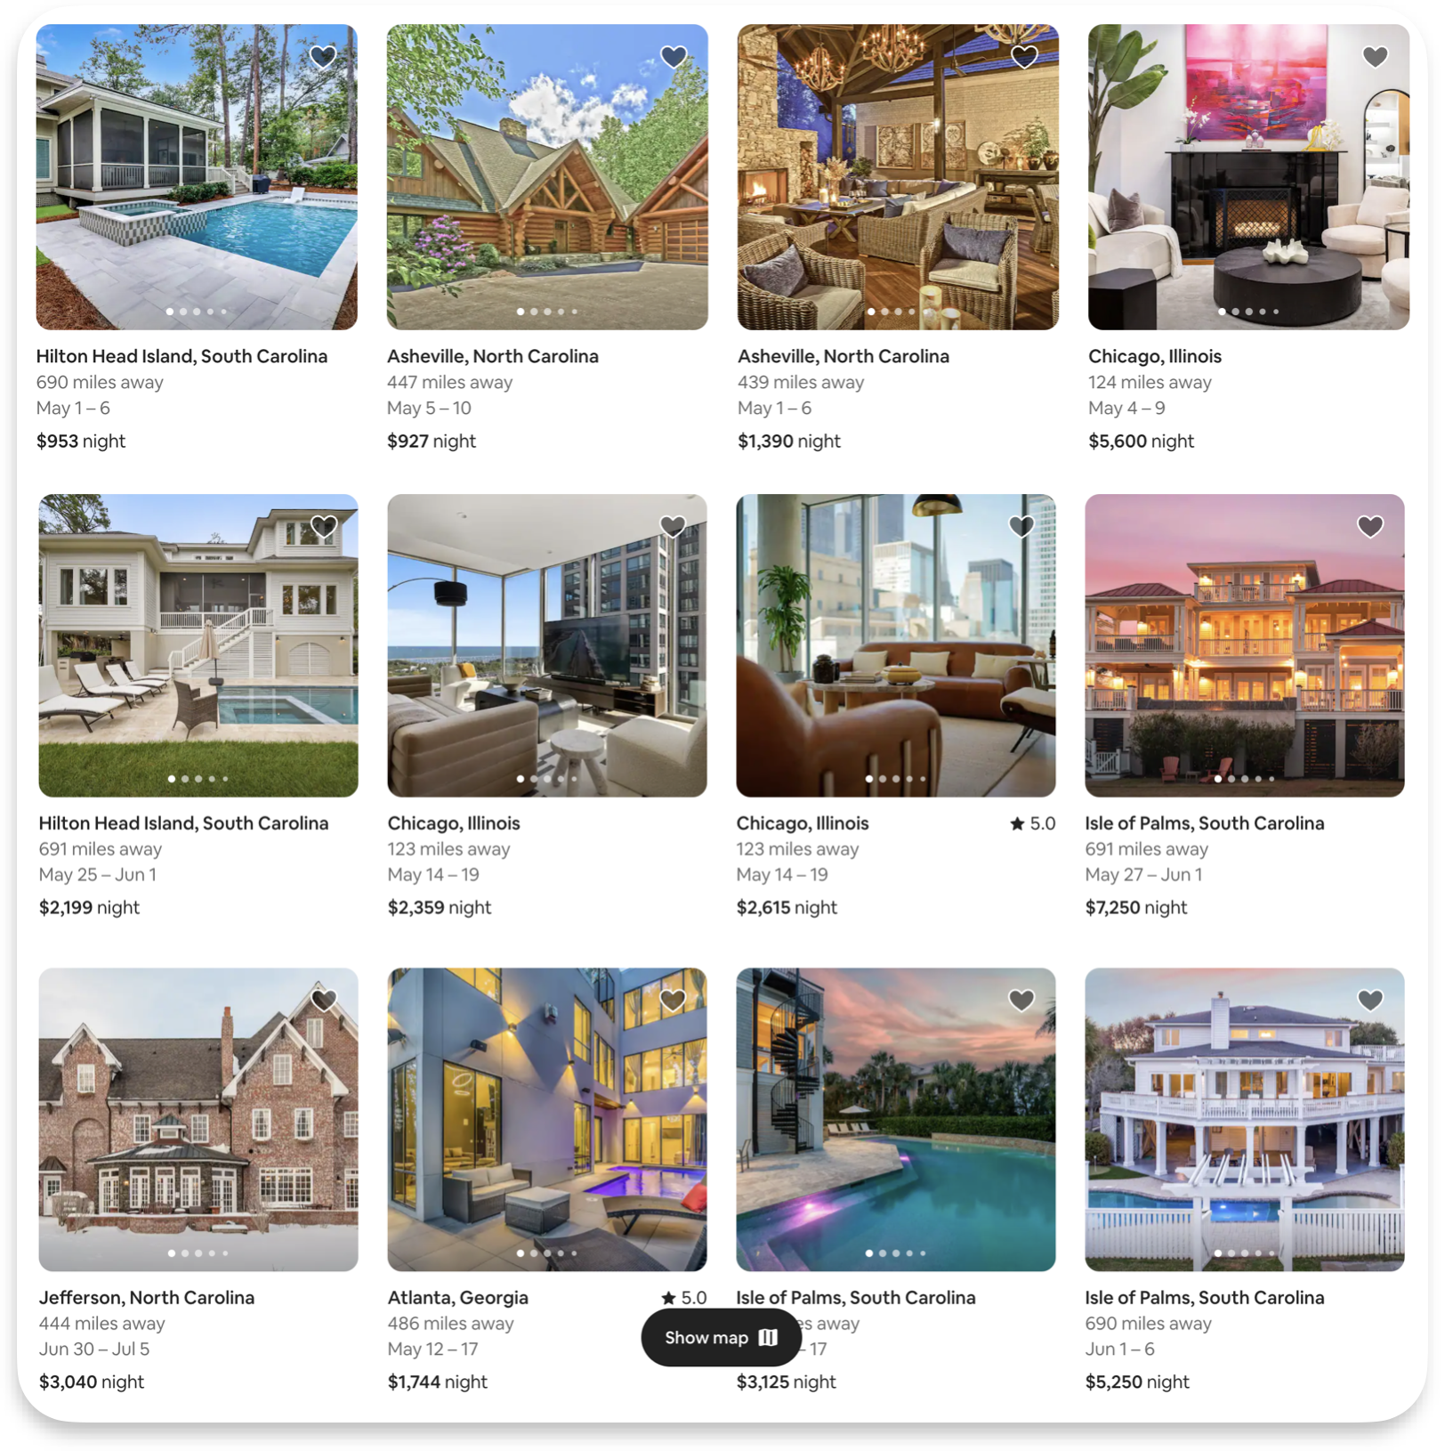
Airbnb Luxe

